Slide 1

DEPARTMENT OF ELECTRONICS AND COMMUNICATION ENGINEERING
Course : Industrial Oriented Mini Project (IOMP) Course Code: ES653PC
AUTOMATED SLOT PARKING WITH BOOKING SYSTEM USING MOBILE APPLICATION
Batch-6 Under the guidance of
M.Pravalika-23261A04F9 Dr.S.Praveena
P.Saaketha - 23261A04G9 (Assistant Professor)
P.Aishwary- 23261A04H1

Slide 2
Contents
Aim of the Project
Abstract
Block Diagram and Circuit Diagram
Methodology
Flowchart
Results
Conclusion
References

Slide 3
AIM OF THE PROJECT:
To design and develop an IoT-based Smart Parking System that integrates a mobile application with real-time hardware simulation to enable users to remotely view slot availability, select specific parking spots, and automate gate entry via a timed booking mechanism.

Slide 4
Abstract:
Urban congestion has led to significant challenges in finding available parking, resulting in fuel wastage and traffic delays. This project proposes a solution using an ESP32 microcontroller (simulated in Wokwi), IR sensors, and the Blynk IoT Cloud.
The system allows users to interact with a mobile dashboard to reserve a spot for a specific duration. A servo-controlled gate automates entry, while an I2C LCD provides local status updates.
By synchronizing the hardware state with the cloud, the project ensures real-time accuracy in slot management and minimizes human intervention.

Slide 5
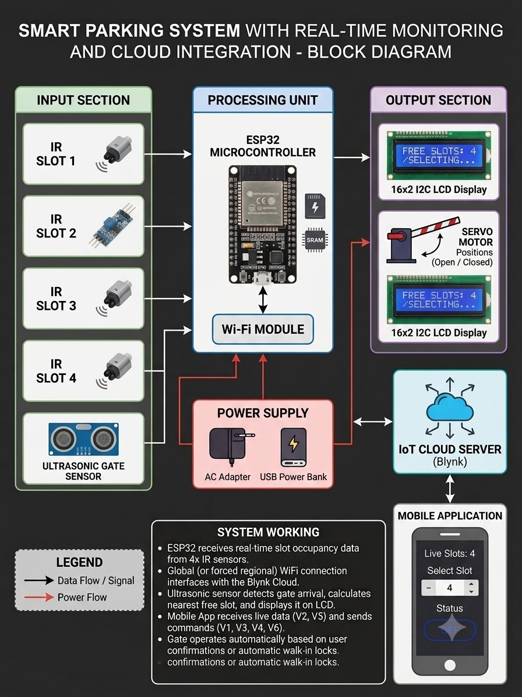

Slide 6
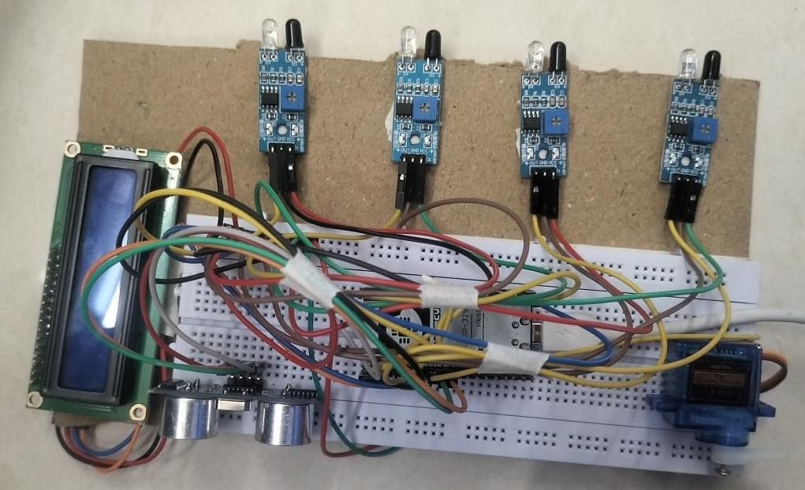
CIRCUIT DIAGRAM:

Slide 7
Methodolody:
Phase I: Hardware Simulation (Wokwi)
Sensing Layer: Four IR Sensors (simulated via digital pins with INPUT_PULLUP) monitor physical occupancy.
Actuation Layer: A Servo Motor acts as the automated gate, controlled via PWM signals.
User Interface: A 16x2 I2C LCD provides real-time local feedback (e.g., "Slot Booked," "System Online").
Phase II: Connectivity & IoT Middleware (Blynk/Firebase)
Data Synchronization: The ESP32 connects to the Wokwi-GUEST virtual network
State Management: Virtual Pins (V1 to V5) handle the bidirectional flow of data.
Persistence: The Cloud Server stores the "Booked" status and "Duration" to ensure data isn't lost if the hardware restarts.
Phase III: Mobile Application Development (Flutter/Blynk)
Dashboard Design: UI widgets (Sliders, Buttons, and Value Displays) are mapped to the Virtual Pins.
Control Logic: The app allows users to select a specific slot, set a timer, and trigger the gate actuation remotely.
Phase IV: Integration & Logic Validation
The Sync Protocol: Using BLYNK_CONNECTED(), the system performs a "handshake" to ensure the hardware and app have matching values (e.g., the timer slider position) upon startup.

Slide 8
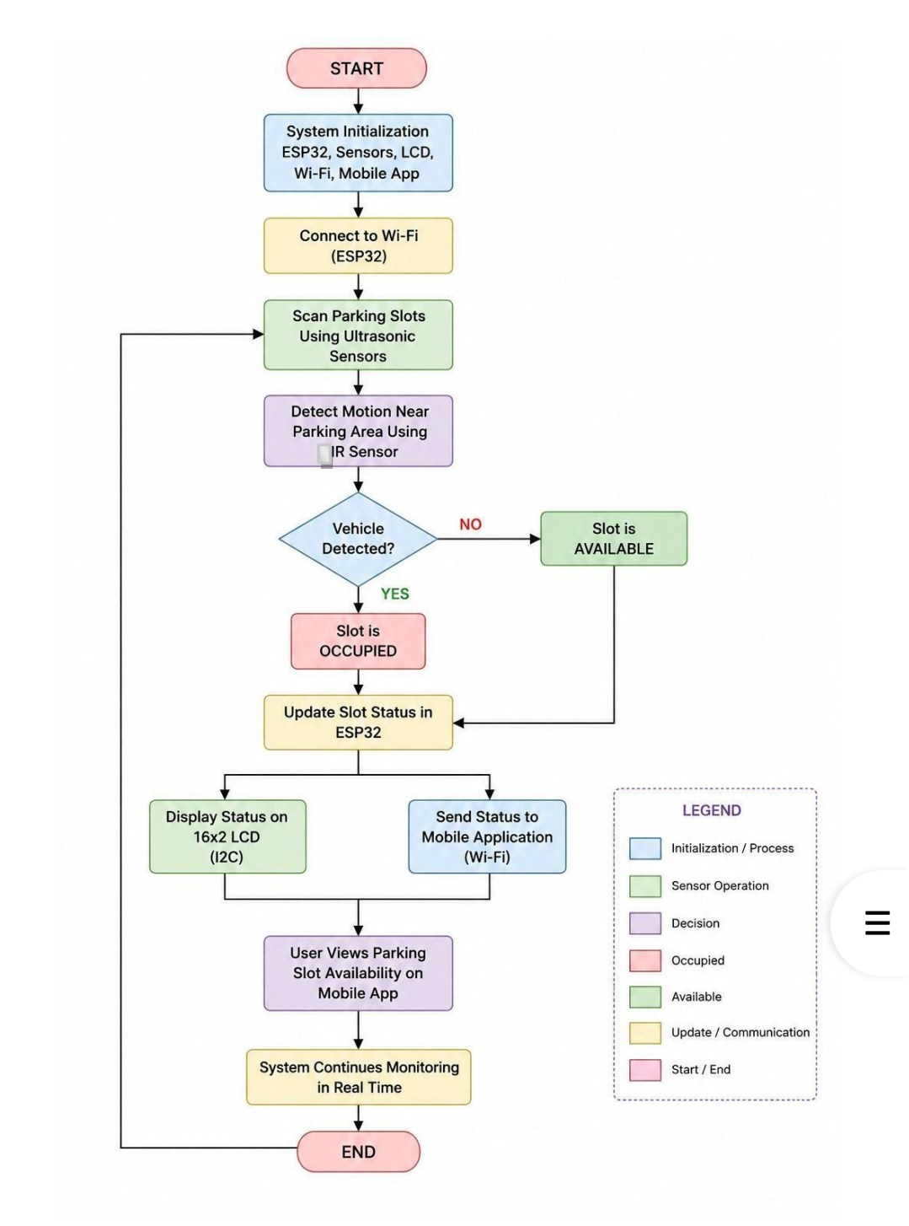
Flowchart:

Slide 9
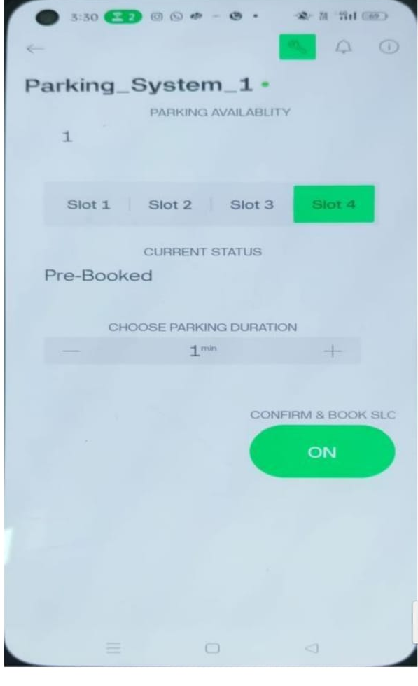
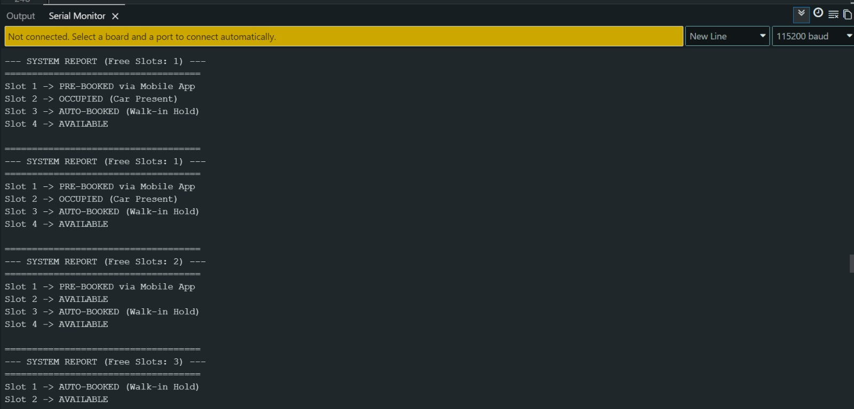
Results
Booking System display in Blynk App:
Screen Monitor:

Slide 10
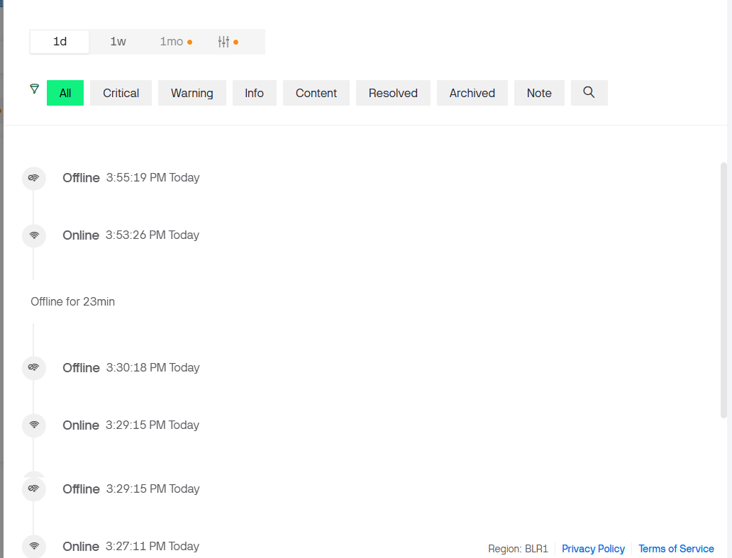
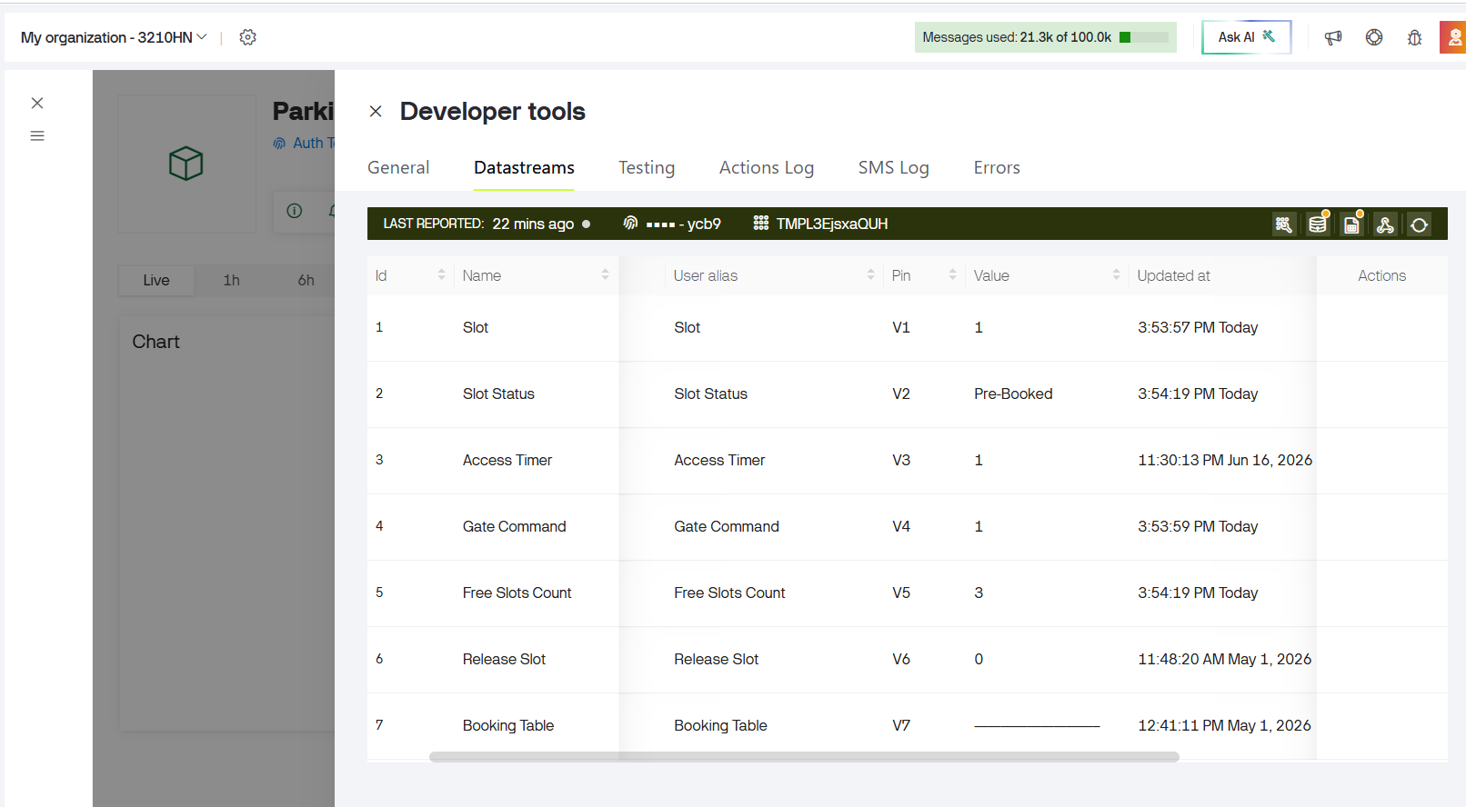
BLYNK CONSOLE:
BLYNK CONSOLE OUTPUT:

Slide 11
CONCLUSION AND FUTURE SCOPE:
The Automated Parking Slot System Using Mobile Application was successfully designed and implemented using ESP32 microcontroller, IR sensors, ultrasonic sensor, servo motor, LCD display, and Blynk cloud platform.
The system effectively monitors parking slot occupancy, provides real-time parking information through a mobile application, and enables automated gate control for vehicle entry and exit. The developed solution reduces parking search time, improves parking space utilization, and enhances user convenience through remote monitoring and reservation features.
Experimental results demonstrated reliable sensor performance, accurate vehicle detection, efficient cloud communication, and effective parking management, making the system suitable for smart parking applications.
In the future, the proposed system can be enhanced by integrating advanced features such as online payment facilities, GPS-based navigation, license plate recognition, and cloud database management. Artificial Intelligence and Machine Learning techniques can be incorporated for parking prediction and optimization, while surveillance cameras and notification services can improve security and user experience.
These enhancements will increase the scalability, efficiency, and intelligence of the system, making it more suitable for large-scale smart city and intelligent transportation applications.

Slide 12
REFERENCES:
[1] Blynk IoT Documentation: https://docs.blynk.io/
[2] Wokwi ESP32 Simulation Guide: https://docs.wokwi.com/
[3] Espressif Systems ESP32 Technical Reference Manual.
[4] Arduino ESP32Servo Library Documentation.

